Slide 1

Predictive Maintenance
By Next Level Analytics

Slide 2









Group Members
Rushikesh Shinde
Manish Soni
Chirag Patil
Jyotsana Parkhedkar
Darshan Chindarkar
Aniruddha Mokashi
Bhakti Raut
Shreya Koshti
Nikhil Mohite

Slide 3
Outline
Introduction
Project Summary
Purpose of Project
Dataset Source
Data Visualization
Conclusion

Slide 4

Introduction

Slide 5
Predictive Maintenance
A game-changing approach to ensure smooth operations, enhance equipment reliability, and optimize maintenance practices. In this session, we will explore the concept of predictive maintenance, its benefits, and how it revolutionizes traditional maintenance strategies.

Slide 6

Predictive Maintenance is a proactive maintenance strategy that utilizes data analysis and cutting-edge technologies to predict potential equipment failures before they occur. By collecting and analyzing real-time data from sensors, historical records, and other sources, predictive maintenance empowers us to anticipate issues and intervene at the right time.

Slide 7

Project Summary

Slide 8
The predictive maintenance project aims to enhance operational efficiency and equipment reliability by proactively predicting potential equipment failures.
Through data analysis and machine learning, the project will transform maintenance practices from reactive to proactive, reducing downtime and optimizing resource utilization.
Objectives include enhancing equipment reliability, reducing costs, improving safety, extending equipment lifespan, and enhancing efficiency.
The project involves data collection, analysis, and modeling, leading to the implementation of a predictive maintenance system.
Expected benefits include reduced downtime, cost savings, improved safety, increased efficiency, and extended equipment lifespan.
Overall, this project will provide a competitive advantage and position the organization as a leader in predictive maintenance practices.

Slide 9
Project Phases
Install advanced sensors and data collection systems on critical equipment to gather real-time performance data.
Generate actionable insights and predictions about equipment health to enable proactive maintenance planning.
Scale up the system to cover all critical equipment, conduct training for maintenance personnel, and continuously optimize its effectiveness.
Data Collection
Predictive Insights
Full-Scale Rollout
Data Analysis and Modeling
Implementation and Testing
Develop and deploy machine learning algorithms to analyze data and identify patterns indicative of potential failures.
Pilot the predictive maintenance system on selected equipment, monitor performance, and make necessary improvements.

Slide 10

Purpose of Project

Slide 11

The purpose of the predictive maintenance project is to proactively manage and maintain equipment and machinery by leveraging data analysis and predictive insights.
The primary objectives and purposes of implementing predictive maintenance are as follows:

Slide 12




Predictive maintenance helps identify potential safety hazards associated with equipment failures. By proactively addressing these issues, companies can create a safer working environment for their employees and reduce the risk of accidents caused by equipment malfunctions.
Safety Enhancement
04
01
Purpose
With predictive maintenance, maintenance activities are scheduled based on actual equipment conditions and performance data. This targeted approach to maintenance ensures that resources are utilized efficiently, minimizing disruptions to operations and maximizing the productivity of equipment.
The main purpose of predictive maintenance is to enhance the reliability and availability of critical equipment and machinery. By predicting potential failures in advance, maintenance can be performed before an issue escalates into a major problem, reducing the likelihood of unexpected breakdowns and unplanned downtime.
Efficiency Improvement
Equipment Reliability
03
02
Cost Reduction
Predictive maintenance aims to optimize maintenance activities, leading to cost savings for the organization. By addressing maintenance issues when they are just starting to develop, companies can avoid costly emergency repairs and unnecessary maintenance activities.

Slide 13

Dataset Source

Slide 14
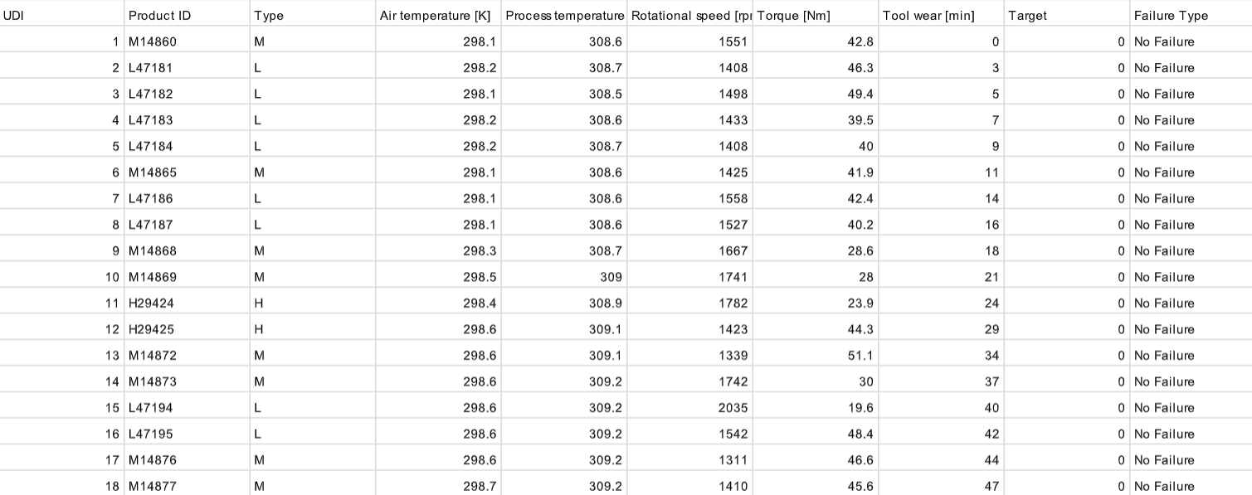
Dataset
Link : https://drive.google.com/file/d/1NUcXpFsLfAt6Id7wSvRmNvJfIqDIWQOL/view?usp=drive_link

Slide 15

Data Visualization

Slide 16
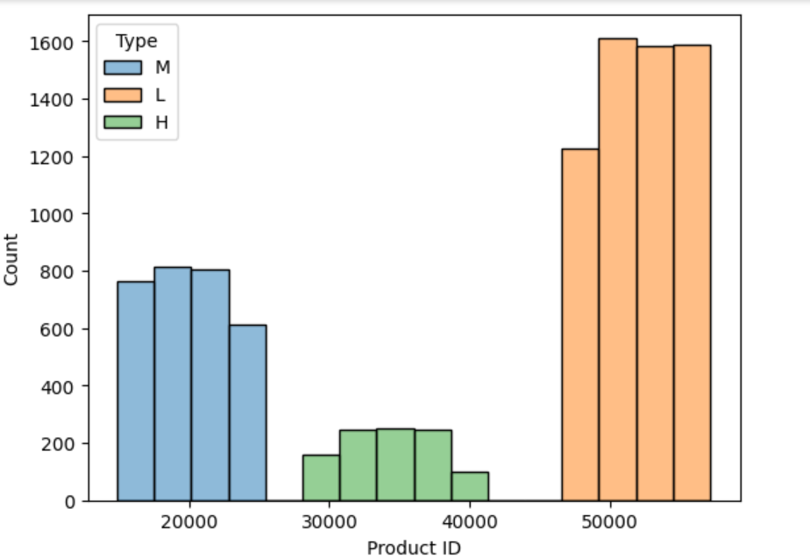
OUTPUT
Graph of Count of machine v/s Products

Slide 17
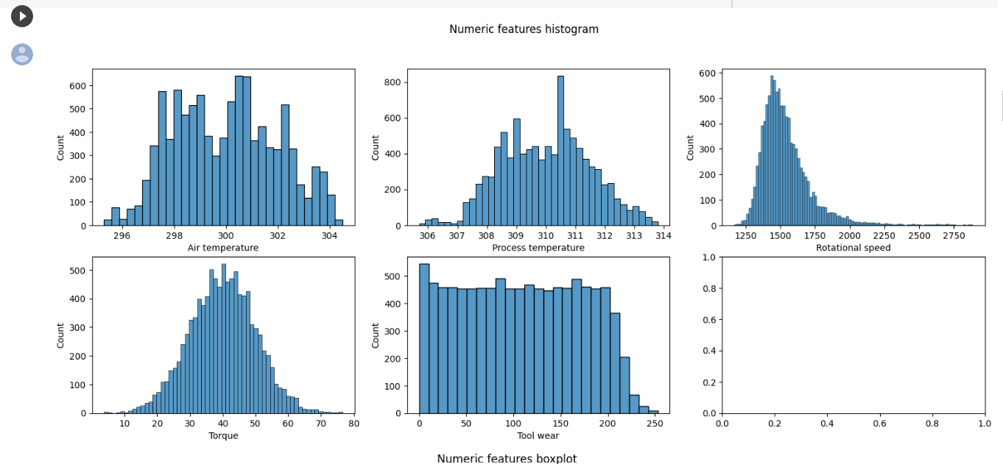
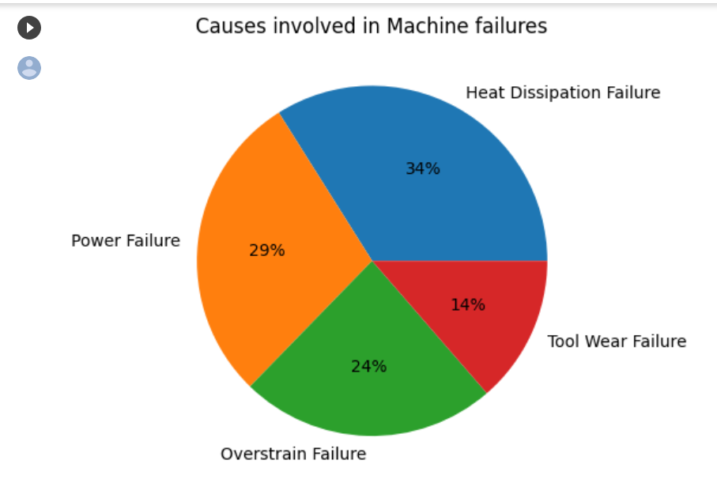
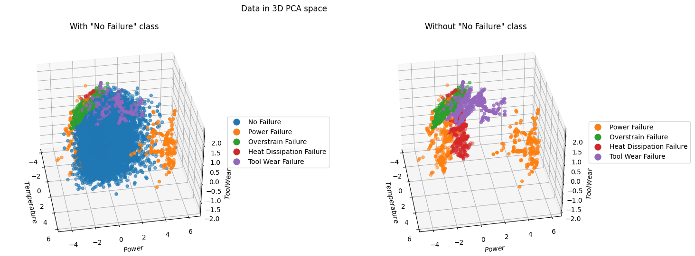
OUTPUT
Histogram
Pie Chart
PCA space

Slide 18
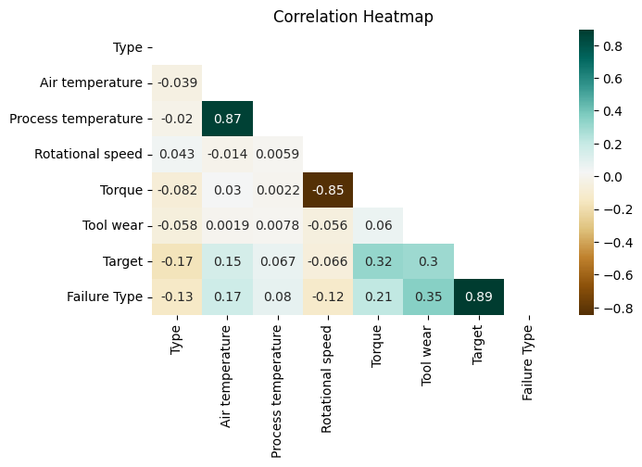
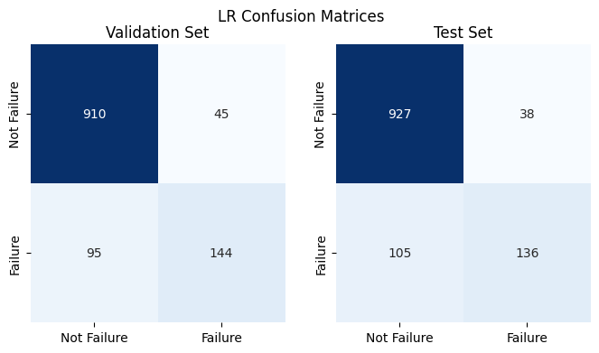
OUTPUT
Heatmap
Confusion matrices

Slide 19
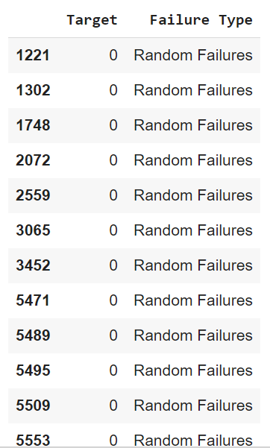
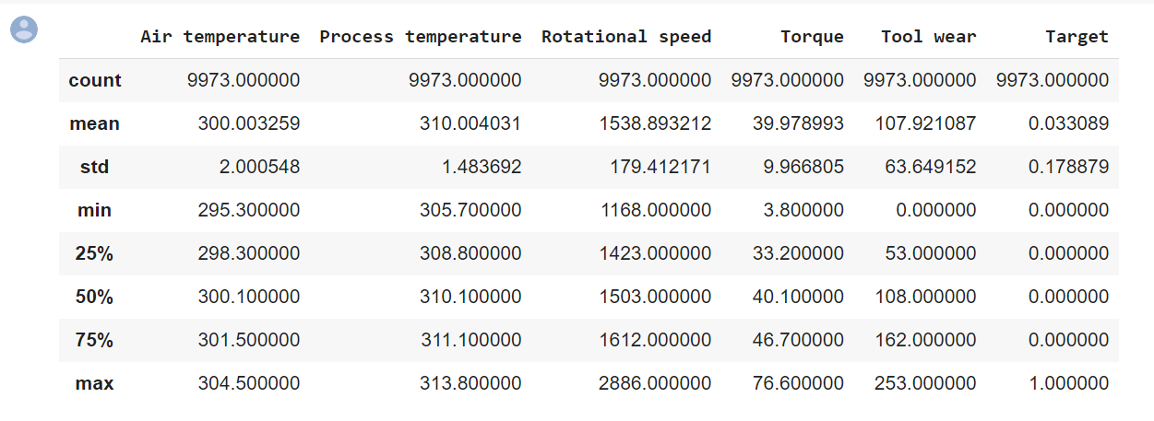
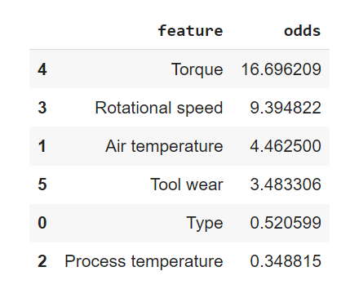
OUTPUT
Data description

Slide 20
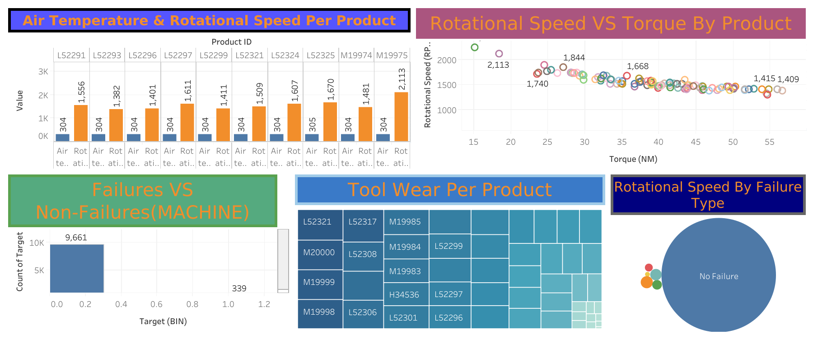
Dashboard

Slide 21

Conclusion

Slide 22
Implementing predictive maintenance will revolutionize our maintenance practices and boost operational efficiency.
By using data analysis and machine learning, we can predict equipment failures in advance, ensuring smooth operations and reducing downtime.
The primary goals of this project were to improve equipment reliability, cut costs, enhance safety, and extend equipment lifespan.
Through advanced sensors and data systems, we've built a solid foundation for predictive maintenance.
Our algorithms can identify patterns and generate valuable insights, enabling proactive maintenance planning.
This approach will save resources, create a safer workplace, and positively impact our bottom line.

Slide 23

Any Questions?

Slide 24
Thank You

